Slide 1
URBAN GAMIFICATION
By Midnight Talkers DBS Team

Slide 2
Urban Harvesting
Urban greening policies are important for revitalizing communities.
Reducing financial burdens of healthcare, and increasing quality of life.
Most policies focus on community benefits.
Reducing negative effects of urban development such as surface run off.
.

Slide 3
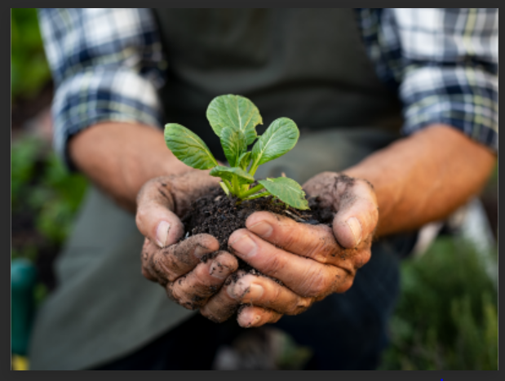
Benefits and Achievements
Aesthetic
Air Quality Index Q1 2023 – Q2 2023*
Pos. | Countries | Average Air Quality Index
1 | Czech Republic | 32
2 | Italy | 59
3 | USA | 53
4 | Turkey | 50
Ecological
Impact on Health
Save Urbanisation
Impact on high Temperatur and Air Quality
Impact on Mental Health
.

Slide 4
THANK YOU !

